Slide 1

PARAMETER PASSING THROUGH JCL
PRESENTED BY
D SAI HARSHITH

Slide 2
What is parameter passing
1.To pass a parameter from jcl to a program ,we use ‘parm=’ keyword with execution statement.
2.Parm parameter is a way to pass data from jcl to the program.
3.The program receives the PARM data by using linkage section.
4.Maximum amount of data which can send to program using the parm parameter is 100 character.

Slide 3
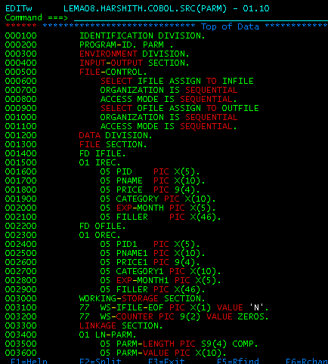
Source code:

Slide 4
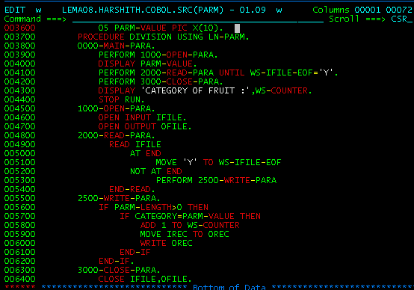

Slide 5
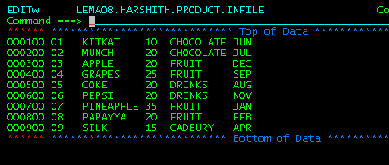
Input file:

Slide 6
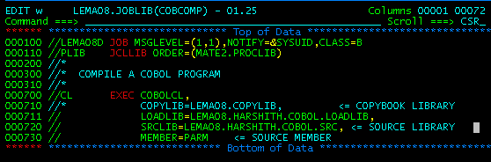
Compile Jcl:

Slide 7
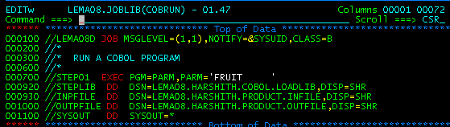
Run Jcl:

Slide 8
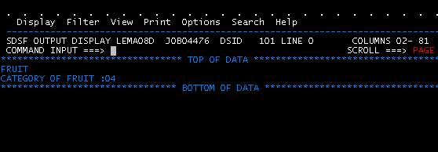

Slide 9
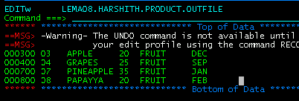
Output:

Slide 10


Thank you
Reimagine technology to
accelerate your business
www.htcinc.com
www.caretech.com
www.ciber.com

